Slide 1

Office
Supplies
Orders
Presented By:
Girdhar, Revati, Murthi, Shashank

Slide 2

CONTENT
01
ABOUT THE PROJECT
02
BUSINESS OBJECTIVE
03
DATA HEALTH REVIEW
04
EXPLORATORY DATA ANALYSIS
05
KPI/ METRIC BASED QUESTIONS

Slide 3





ABOUT PROJECT
We were given the office suppliers dataset.
The nature of the business was to take online orders and supply them to customers of different types

Slide 4





BUSINESS OBJECTIVE
Objective n° 1
Objective n° 2
Objective n° 3
To analyze its historic orders information for understanding how its business performs across different markets
The company wanted to analyze how its business performs across different segments
The company wanted to analyze how its business performs across different product categories

Slide 5

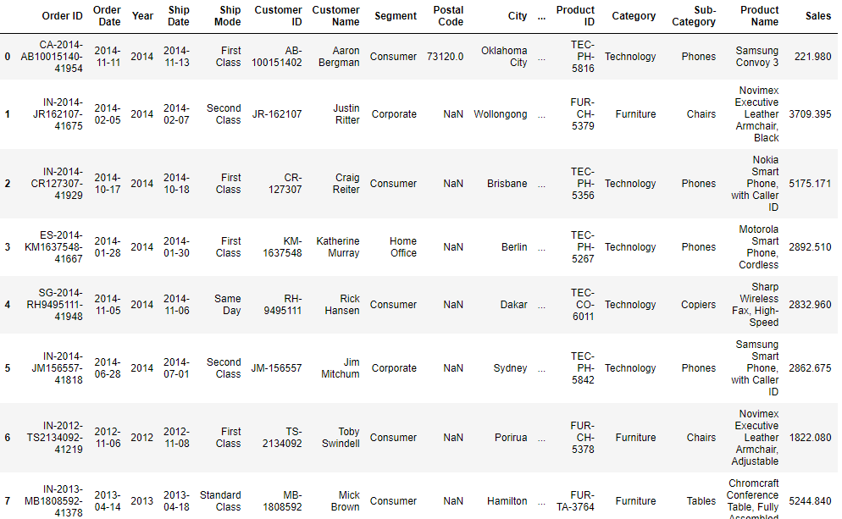
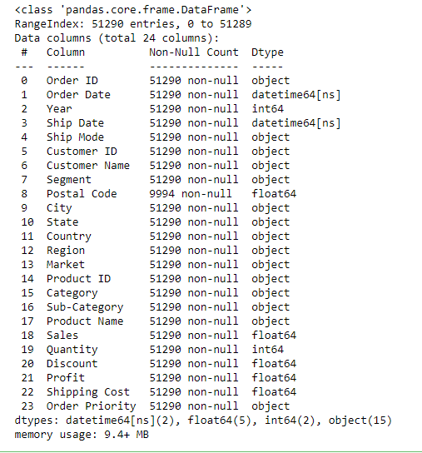
DATA HEALTH REVIEW
The data set contains 51,290 rows and 24 columns.
All columns are proper format and only postal code column contain null values so we dropped postal code column for further analysis

Slide 6
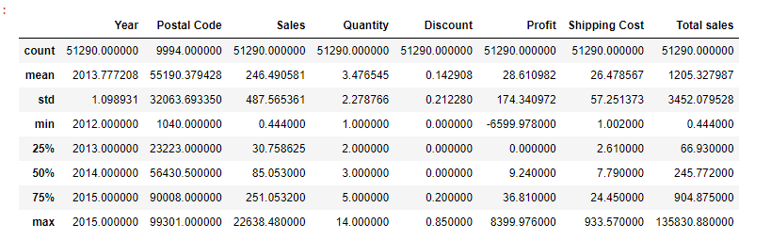
DATA HEALTH REVIEW
STATISTICAL SUMMARY

Slide 7
EXPLORATORY DATA ANALYSIS

Slide 8

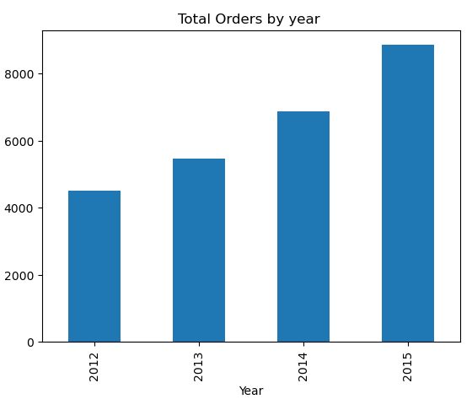
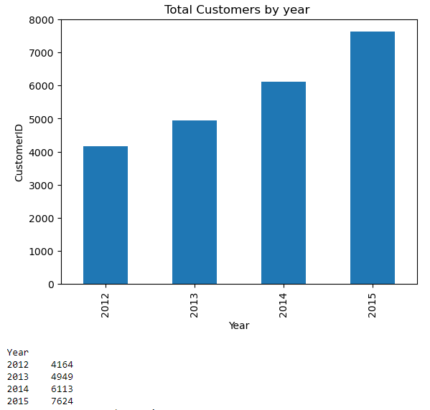
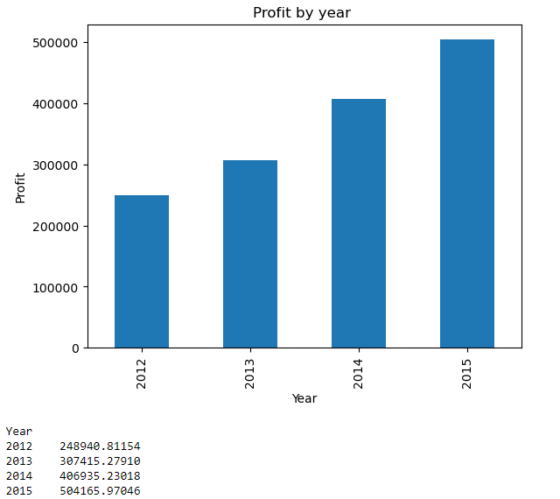
UNIVARIATE ANALYSIS
Upon analyzing total orders by year, we analysed that every year orders have been increasing.
Upon analyzing total customers by year, every year customer gaining is in uptrend
Upon analyzing total profit by year, we analysed that every year orders have been increasing.

Slide 9
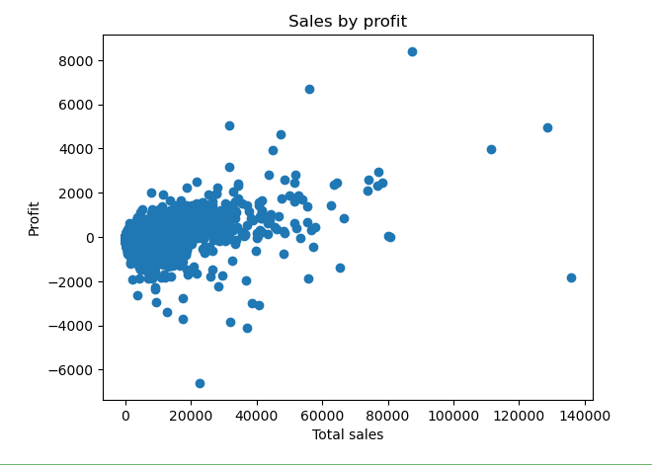
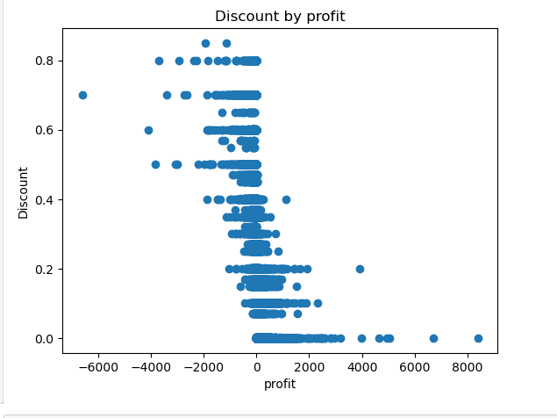
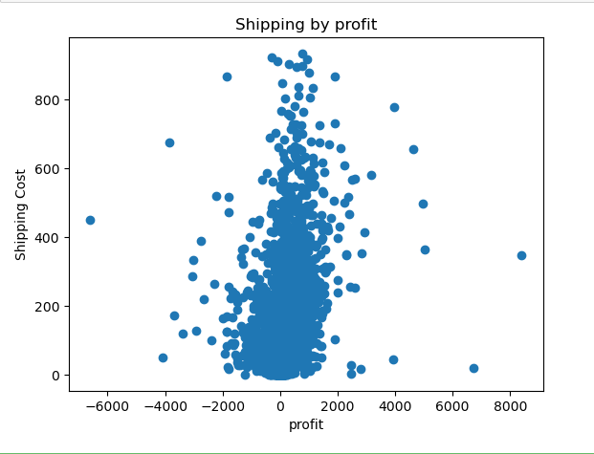
BI-VARIATE DISTRIBUTIONS
As sales are increasing profit is increasing.
Discounts are affecting the profit margin
Shipping cost doesn't really show an impact on the profit.

Slide 10
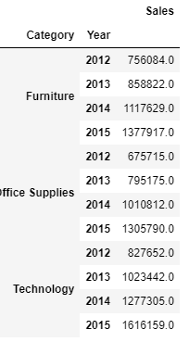
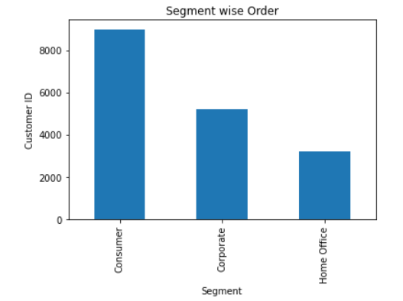
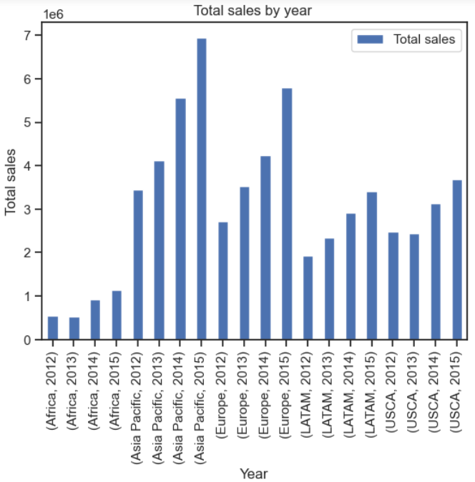
BI-VARIATE DISTRIBUTIONS

Slide 11
KPI/ METRIC BASED QUESTIONS

Slide 12
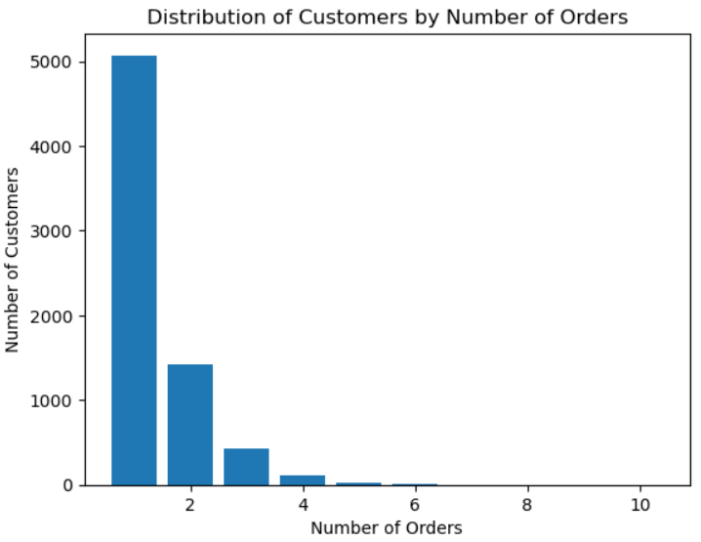
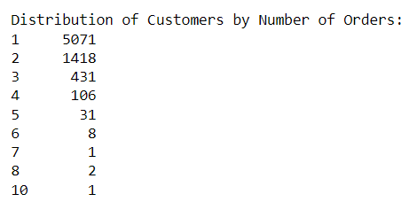
DISTRIBUTION OF CUSTOMERS
BY NUMBER OF ORDERS

Slide 13
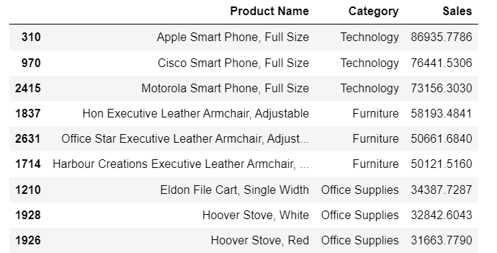
TOP 3 PRODUCT FROM DIFFERENT CATEGORIES WITH HIGH SALES

Slide 14
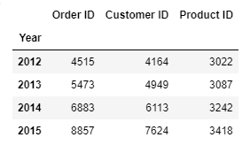
SUMMARY TO REPORT FOR
ORDER ID, CUSTOMER ID & PRODUCTS
Unique Customers
17,415
Unique Products
3,788

Slide 15
REPEAT CUSTOMERS
Customers with a single order
71.74%
Customers with repeated orders
28.26%

Slide 16
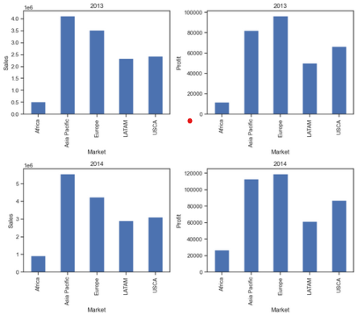
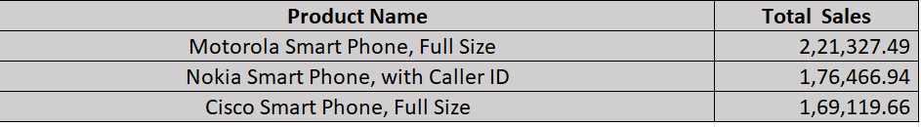
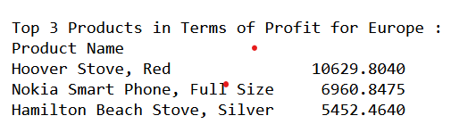
BIGGEST MARKET -ASIA-PACIFIC
TOP 3 PRODUCTS IN TERMS OF SALES FOR ASIA PACIFIC
ASIA-PACIFIC HAVE HIGHER SALES BUT EUROPE GIVES MAX PROFIT

Slide 17
HIGHLIGHTS
Most of the customers opted for Standard class shipping mode
The top Customer is Muhammed Yedwab from California
(who ordered max times 108).
Asia Pacific market has High sales
Office supply category products have been ordered many times
Every year the order, Customers, profit and sales are increasing - UP trend
Consumer Segment has max customer, max sales
Discount is inversely proportional to Profit
Customers who increased their order count every year are null customer
Top 3 products from the Asia Pacific i.e largest market w.r.t sales
1)Motorola Smart Phone, Full Size 221327.4918
2)Nokia Smart Phone, with Caller ID 176466.9420
3)Cisco Smart Phone, Full Size 169119.662
Discount is inversely proportional to sales as the company had given more discount to the product which have low sales.

Slide 18
HIGHLIGHTS
Top 3 customers in the last year 2015 who ordered many times
1) Jane Waco 2015 24
2) Christine Sundaresam 2015 22
3) Bruce Degenhardt 2015 22
Number of unique customers in the last 4 years: 7069
Percentage of customers with single orders: 71.74%
Percentage of customers with repeat orders: 28.26%
Even though Asia pacific market has high sales Europe had given the higher profit
More discounts lead to less profit or loss (Discount in the range up to 18% is ok)
Most of the orders takes 4-5 days for delivery (i.e 20%-25%)

Slide 19
Thank you

